Slide 1
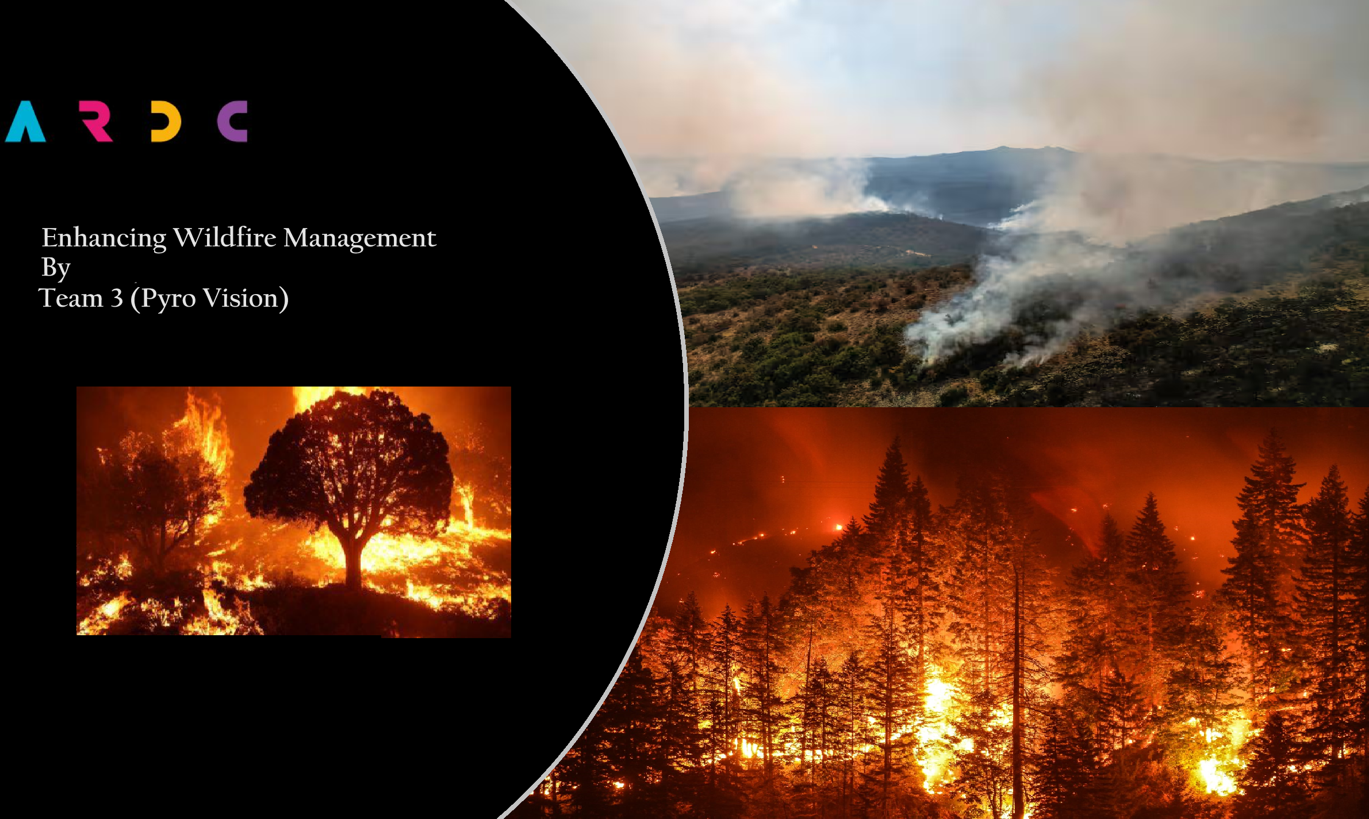
Enhancing Wildfire Management
By
Team 3 (Pyro Vision)

Slide 2
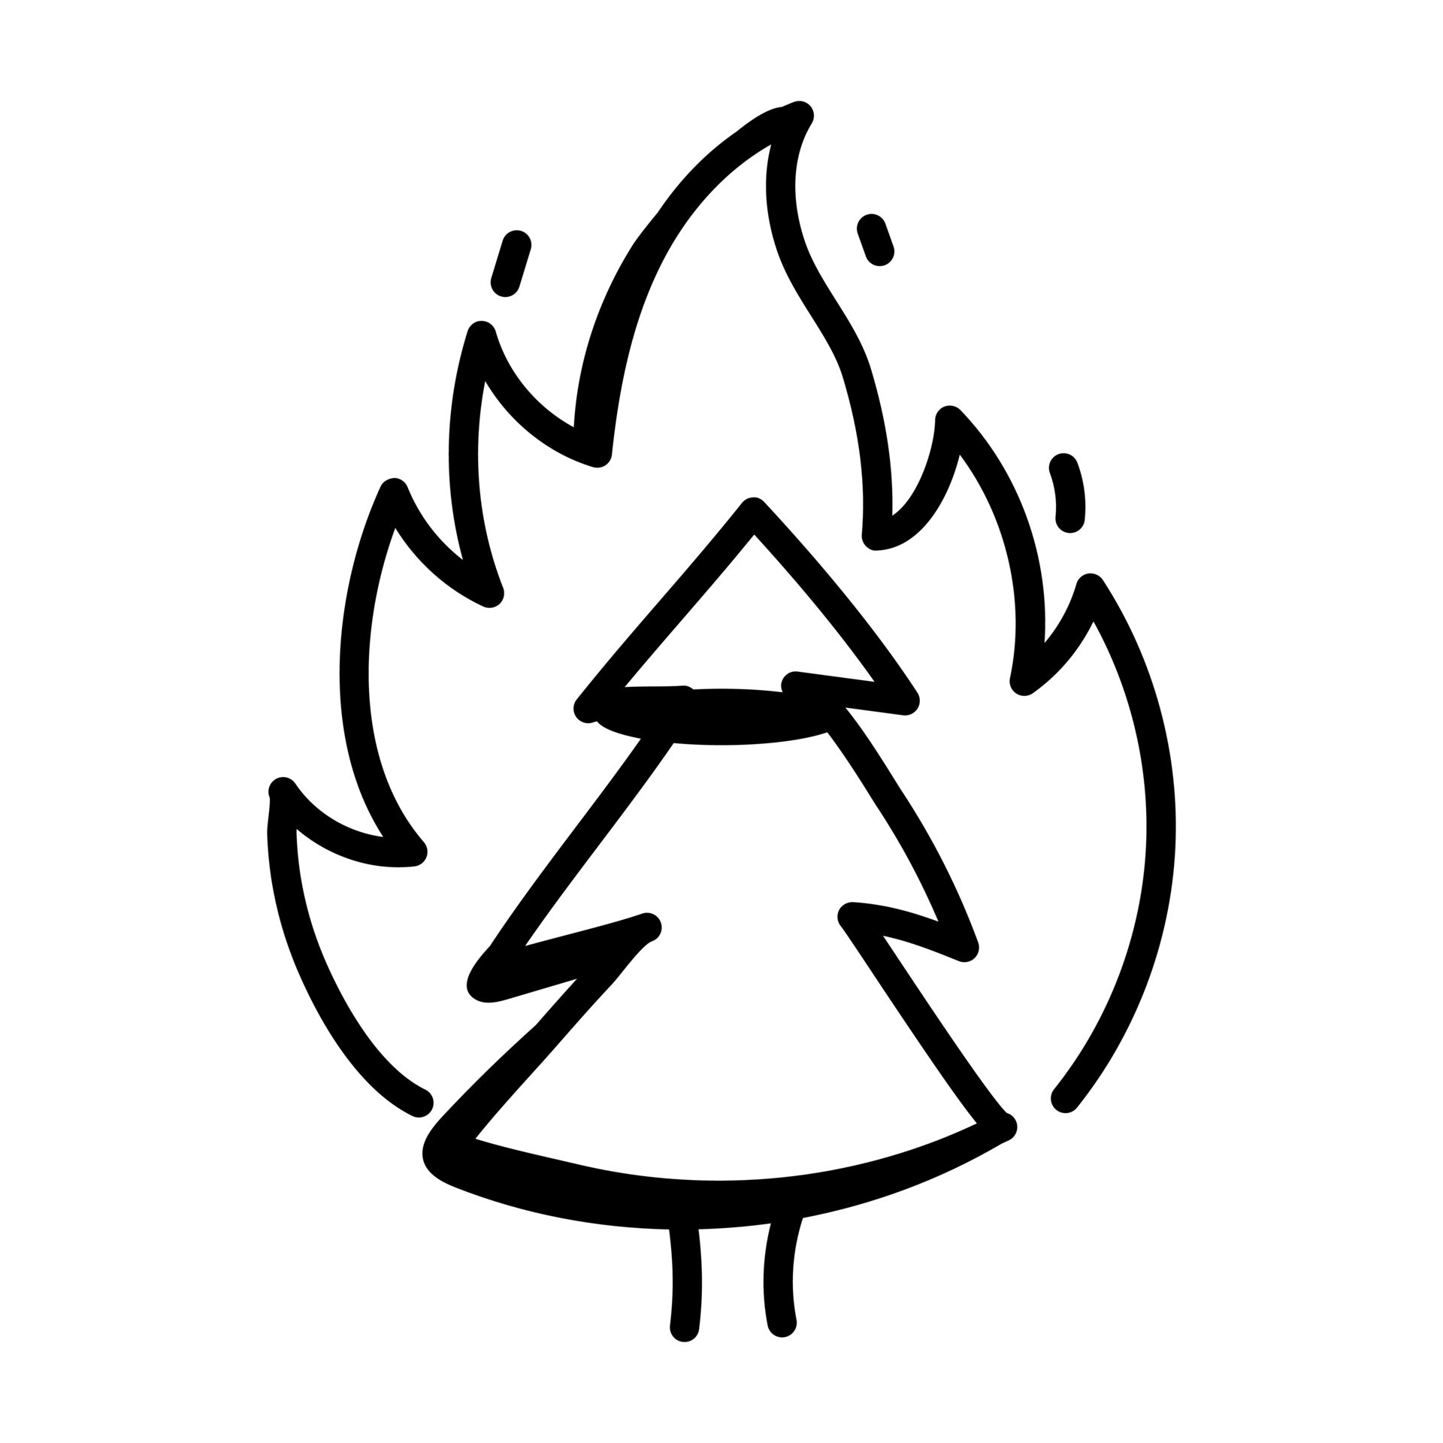


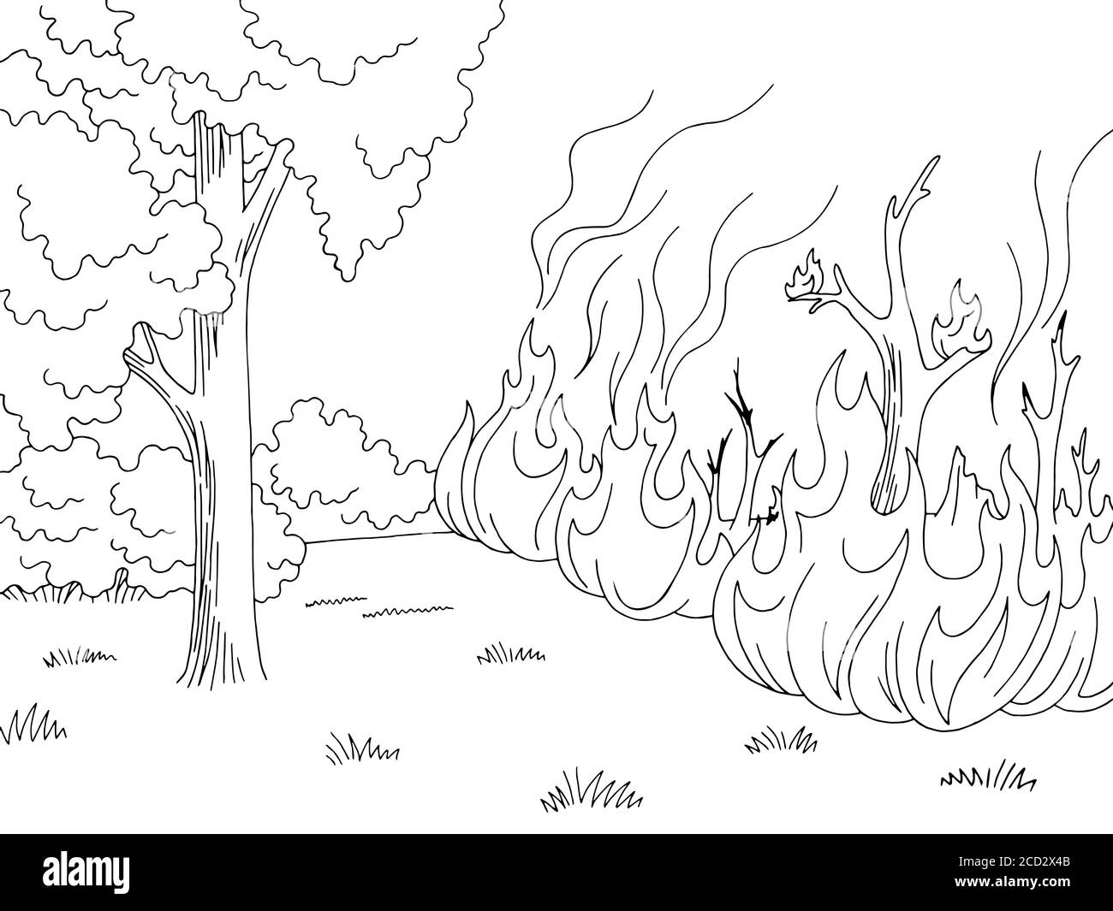
Introduction
Good evening to all respected tutors and other team members.
We are 'Pyro Vision’, a group of passionate individuals, committed to utilizing machine learning and data science to address the critical environmental issue related to wildfires.
Today, we'll take you on a journey through our project, sharing our insights and strategies.
We believe that by the end of this presentation, you'll gain a deep understanding of our project's significance and the direction we're heading.
The topic of our project is “Enhancing wildfire management”. A case study of Greece.

Slide 3
Team Members and their Roles
Our group comprises of four team members, each bringing unique expertise to this project.
Role | Name | Work
Project Manager | Shivani | Responsible for overall project coordination. Ensures timelines are met. Allocates resources effectively. Facilitates communication among team members.
Data Collection and Sourcing Specialist | Ahmed & Shivani | Responsible for sourcing and collecting wildfire and temperature datasets. Ensure data quality and reliability.
Machine Learning Model Developer | Nutan | Leads the development of the wildfire prediction model using machine learning techniques.
Data Cleaning | Ashutosh | Responsible for data preparation and cleaning of data.
Data Visualization and Reporting Analyst | Ahmed | Creates visualizations to represent wildfire data, such as burned areas and cost estimates. Generates reports that convey project findings effectively.
Smoke Detection Algorithm Developer(images) | Shivani & Ashutosh | Focuses on developing smoke detection algorithms for images.
Smoke Detection Algorithm Developer(video) | Nutan & Ahmed | Focuses on developing smoke detection algorithms for video data.
Project Documentation and Presentation Lead | Pyro Vision whole team | Responsible for documenting the project's progress, methodologies, and results. Prepares presentations, reports, and documentation for project submission.

Slide 4
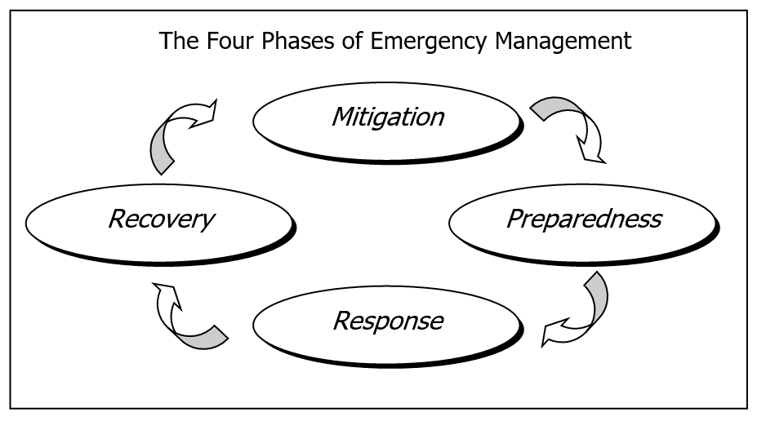
Project Background
The four phases of emergency management
Since World War II, emergency management has primarily focused on preparedness, often geared toward enemy attack scenarios.
Community preparedness for all types of disasters involves identifying resources and expertise in advance and planning for their utilization during a disaster.
Preparedness is one of four key phases in modern emergency management.
The four phases of emergency management are:
Given this framework, we have chosen to address the wildfire crisis problem and apply data science tools to develop a comprehensive plan covering all four phases of emergency management.

Slide 5
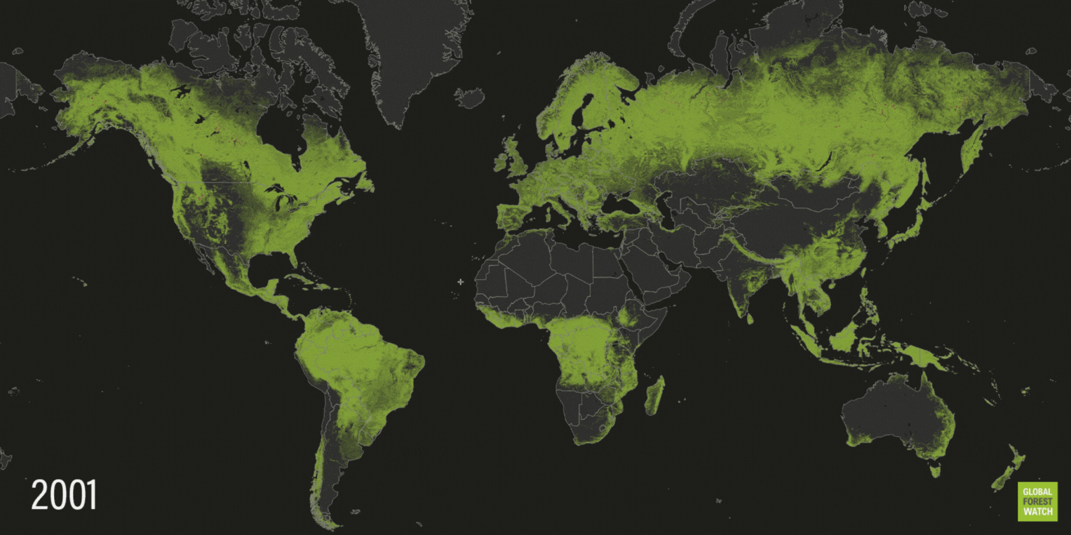
Project Background
Wildfire: A Global Concern
The phenomenon of wildfires is not new to our planet. However, recent years have witnessed an alarming increase in the frequency and intensity of these fires across the globe.
From the vast rainforests of the Amazon to the bushlands of Australia, no region has remained untouched. The consequences are multifaceted, affecting the environment, economy, and human settlements.
Tree cover loss from fire over the past 20 years is shown in dark. Time-lapse provided by World Resources Institute (WRI) via GFW.

Slide 6
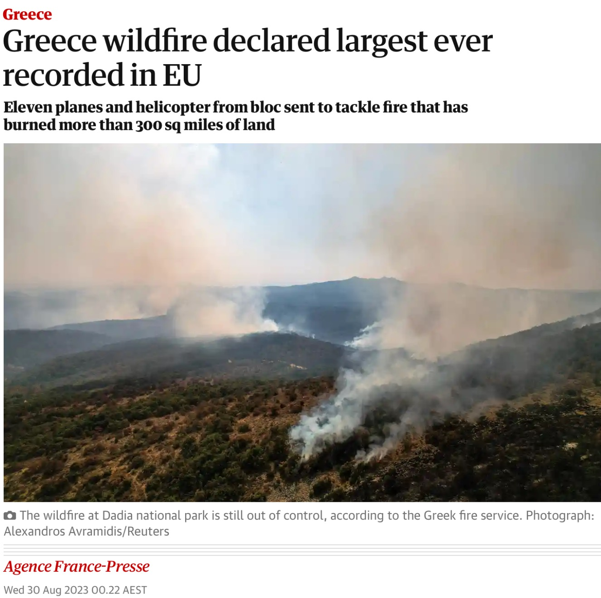
Greece: A Nation Under Siege
Project Background
Greece, with its Mediterranean climate and extensive forested areas, has always been susceptible to wildfires.
However, the past decade (2013-2023) has seen an unprecedented surge in these destructive events.
Each year, news headlines relay harrowing tales of villages evacuated, ancient forests reduced to ash, and sadly, lives lost.
Notably, in August 2023, Greece faced the largest wildfire in the European Union.
This recent development in August 2023 is a key reason why our group, Pyro Vision, has chosen Greece as the focal point for our wildfire research efforts.

Slide 7
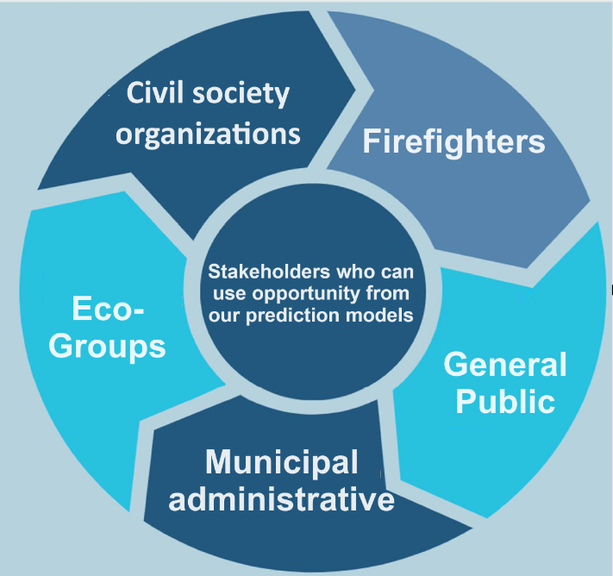
Goal 1: Prediction of Wildfire Occurrence in Greece
Project Scope: Goals and Direction
Our primary goal is to develop a robust machine learning model that predicts wildfire occurrences in Greece.
We aim to utilize our machine learning expertise gained from our coursework to create an accurate prediction system.
We will use data sourced from various reputable sources, including the NASA firm website, to train, validate, and test our model.
The training dataset will encompass data from 2013 to 2019, the validation dataset from 2019 to 2022, and the testing dataset from 2022 to 2023.
The outcome of this prediction model will enable more intensive monitoring in potential fire-prone areas, aiding in preparation and mitigation efforts.
The outcomes of our prediction model hold the potential to benefit a diverse range of stakeholders, including:

Slide 8
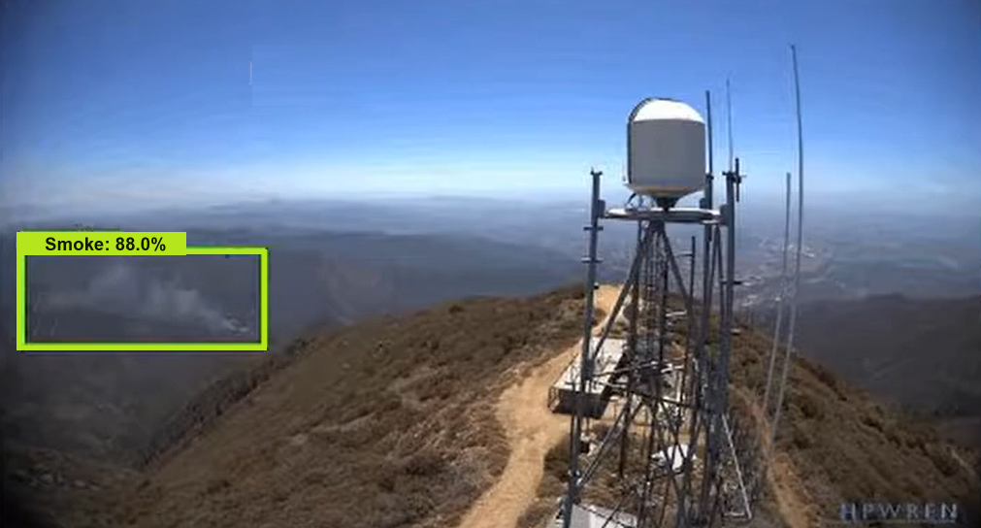
Goal 2: Smoke Detection for Unstructured Data.
Project Scope: Goals and Direction
Our second goal involves developing a smoke detection system, for areas during wildfire situations.
This system will provide early alerts to response teams, ensuring the safety of firefighters, efficient resource allocation, and effective evacuation planning.
Real-time data on fire progression will be crucial in reducing property damage, economic costs, and environmental impact.
Our motivation for pursuing this goal is to contribute to enhancing wildfire response and management.
This Smoke detection technology offers valuable data and early valuable capabilities that benefit a wide range of stakeholders, from emergency responders and local authorities to property owners and environmental agencies.

Slide 9
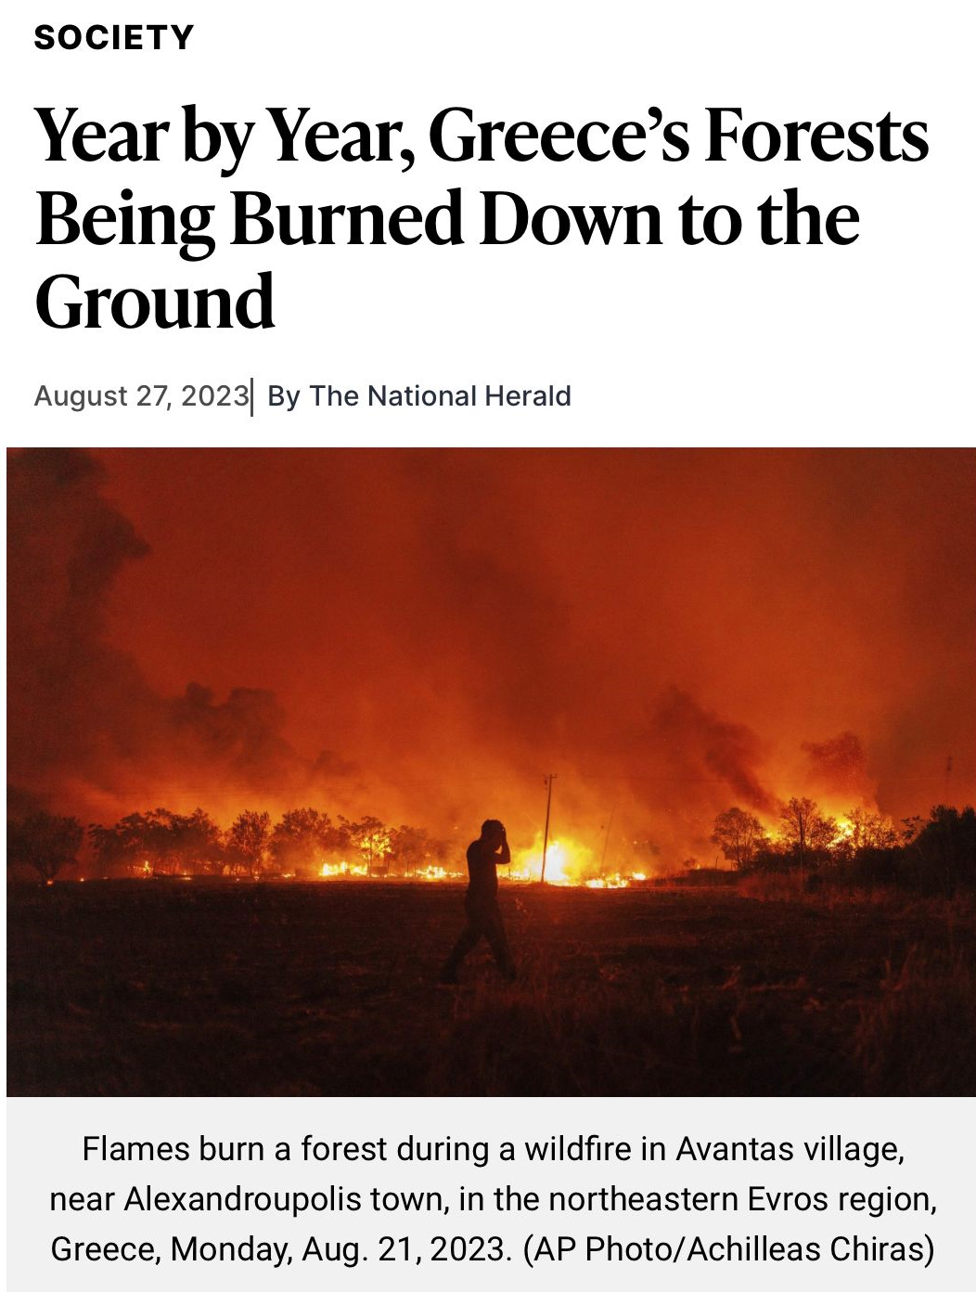
Goal 3: Visualizing Area Burned by Wildfires (2013-2023) in Greece
Project Scope: Goals and Direction
In addition to prediction and response, our project aims to address the recovery aspect.
We plan to visualize the extent of land burned by wildfires in Greece annually from 2013 to 2023.
We will also estimate the cost of suppressing wildfires per fire in Greece.
This visualization will shed light on the recovery side, showcasing the long-term impact of wildfires and the associated financial burdens.

Slide 10
Data Sources, Data processing and technique Used.
Data and techniques Used.
Aspect | Data Sources | Data processing | Techniques Used
Prediction of Wildfire Occurrence | Wildfire: Nasa Firms Temperature: Berkeley Earth | Data preparation and cleaning. Merging of both datasets. | Regression, Classification, Time
 | https://firms.modaps.eosdis.nasa.gov/download/create.php https://berkeleyearth.org/data/
Smoke Detection | Image Analysis | Detection Methodology | Classification using Neural Network
 | https://hpwren.ucsd.edu
Visualising Area burned by wildfires | Burned area data, Estimated | Data Cleaning. | Data Visualization Tool PowerBI
 | https://www.statista.com/statistics/1264709/area-burned-by-wildfire-in-greece/

Slide 11
Prediction of Wildfire Occurrence in Greece
Current Progress
 | Main Task | Progress
Wildfire Data | Data Collection and Sourcing | Completed
 | Data Pre-processing | Completed
 | Feature Selection and Engineering | Completed
 | Data Splitting
Temperature Data | Data Collection and Sourcing | Requested (In progress)
Merged Data (Wildfire + Temperature) | Data Merging | In progress
 | Model Selection | In progress
 | Model Training and Validation | In progress
 | Evaluation and Testing | In progress
 | Results Analysis and Interpretation | In progress

Slide 12
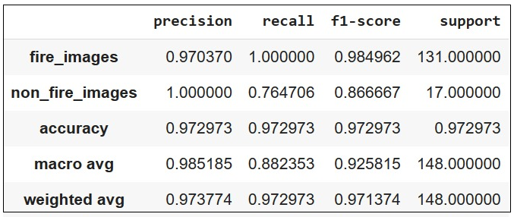
Smoke Detection
Current Progress
Base Model Development: Our initial focus was on creating a baseline model for smoke detection using Neural Networks.
Training Data: We utilized a dataset comprising fire and non-fire images to train the model, enabling it to predict fire and smoke occurrences.
Performance Evaluation: To assess the baseline model's effectiveness, we evaluated its performance using key metrics: accuracy, recall, and F1 score.
Results Table: The table below summarizes the results of our baseline model:

Slide 13
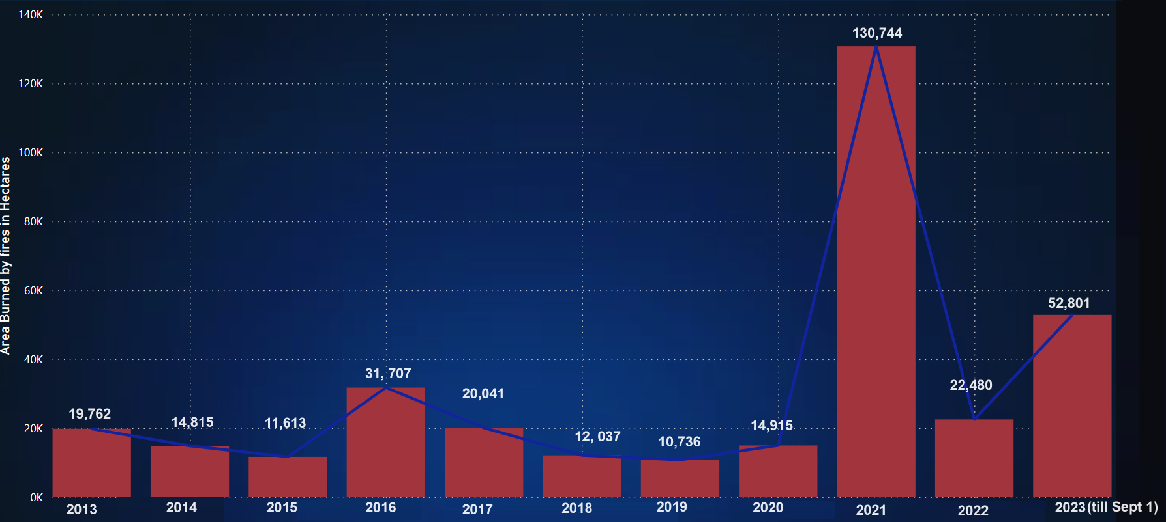
Visualising Area Burned by Wildfires (2013-2023) in Greece
Current Progress

Slide 14
Visualising Area Burned by Wildfires (2013-2023) in Greece
Current Progress
Key Findings
Aspect | Description
Trends Over the Decade | Upon visualizing the area burned by wildfires from 2013 to September 2023, we have uncovered several key findings.
Yearly Variations | Significant variations in the area burned from year to year are evident.
Notable Spikes | Particularly, 2021 and 2023 recorded exceptionally high burned hectares. It's important to note that our data for 2023 is up to September, and the figures for the entire year may not be final.
Overall Patterns | Despite fluctuations, we may identify overarching patterns or cycles that warrant further investigation.
Outcomes
Outcome | Description
Recovery Insights | This visualization provides valuable insights into the recovery aspect of wildfire management
Long-Term Impact | Highlighting the cumulative damage caused by wildfires underscores the long-term environmental and economic consequences.
Informing Recovery Strategies | These insights can be instrumental in formulating recovery strategies, emphasizing the need for sustainable restoration efforts and proactive fire prevention measures.

Slide 15
Prediction of Wildfire Occurrence in Greece
Future Work
The wildfire dataset is prepared, cleaned, and ready for analysis.
Our next steps depend on the timely receipt of the temperature dataset we've requested.
Once received, we will proceed with the following actions: Temperature data processing, data merging, data cleaning, data creation, model tuning and model training.
The prediction model for our wildfires can significantly assist in the mitigation and preparation phases of emergency management.
Below, we outline how the model's capabilities benefit each phase, along with the corresponding actions it enables.
Mitigation Phase | Benefit | Action
Identifying High-Risk Areas | The model identifies regions prone to wildfires. | Aids in targeted mitigation efforts.
Resource Allocation | Enables efficient allocation of firefighting resources and funds. | Resources are directed to high-risk areas for proactive prevention.
Community Awareness | Raises awareness among high-risk communities. | Promotes fire-safe practices and preparedness.
Preparation Phase | Benefit | Action
Early Warning Systems | Provides timely alerts to authorities, residents, and response teams. | Allows for timely evacuation and resource mobilization.
Resource Planning | Supports resource planning and staging in high-risk areas. | Ensures readiness for emergency response.
Evacuation Routes | Informs the development of safe evacuation routes and assembly points. | Enhances the safety of at-risk residents during evacuations.
Community Education | Tailors educational programs to high-risk communities. | Promotes safety awareness and emergency preparedness.

Slide 16
Smoke Detection in Recent Greece Wildfires Videos
Future Work
We have successfully tested smoke detection on static images, and our next endeavour is to apply smoke detection to recent wildfire videos in Greece.
By analysing these videos, we aim to develop a responsive action plan that can be initiated in real-time to address wildfire incidents effectively.
So our plan of action is future will be like:
Objective | Develop a real-time fire detection system using YOLOv5, with a focus on images and videos, to ensure swift responses.
Training Data | Utilize videos captured by real-time hardware cameras for model training, creating a dataset that mirrors real-world scenarios.
Performance Enhancement | Implement continuous performance improvements to optimize the model for real-time fire detection, reducing response time.
Rapid Detection | Strive to build a model capable of detecting fires within minutes of ignition by a real-time camera, minimizing potential damage.
Emergency Signals | Upon fire detection, trigger automatic emergency signals to nearby response teams and volunteers for immediate intervention and efficient disaster management.

Slide 17
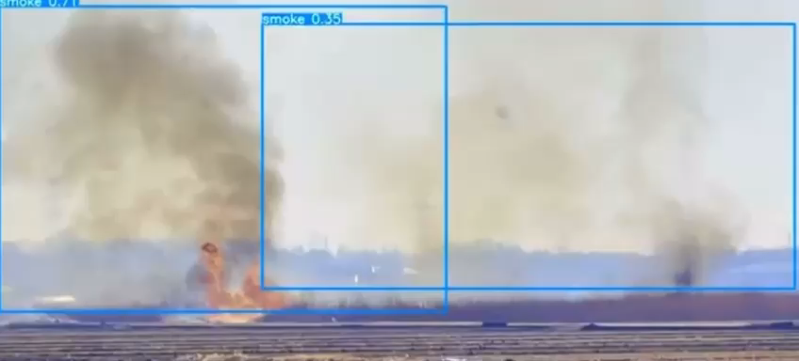
Smoke Detection in Recent Greece Wildfires Videos
Future Work
Implementing project objectives by learning from diverse sources and adapting them to project requirements.
Specific focus on applying smoke detection to recent wildfire videos in Greece for system development and validation.
Utilizing real-world incident videos as authentic data sources.
Providing an example of how the wildfire video format will resemble that of YouTube for clarity and reference.

Slide 18
Visualising Estimated cost to suppress wildfires per fire in Greece
Future Work
After visualizing the area burned by wildfires in Greece from 2013 to 2023.
Next, we will create visualizations depicting the estimated cost to suppress wildfires per fire in Greece.
These visualizations will serve as a crucial foundation for building an informed and data-driven recovery plan.
Understanding the economic impact of wildfires will be a key factor in formulating recovery strategies.
These strategies will address both ecological restoration and the financial aspects of recovery.
This approach ensures a comprehensive and effective response to post-wildfire restoration efforts.
We believe that these visualizations will serve as a crucial foundation for building an informed and data-driven recovery plan, addressing both ecological restoration and the financial aspects of recovery.
By understanding the economic impact of wildfires and leveraging these insights, we ensure a comprehensive and effective response to post-wildfire restoration efforts, fostering a resilient and sustainable future for the affected regions.
API Integration (Optional)
Upon completing all phases of the project, there is a potential plan to develop an API.
This API will provide easy access to the fire detection system.
It is designed to allow integration into various applications and alerting mechanisms.
The primary goal is to enable real-time communication with emergency response teams.
The API's development aims to broaden the utilization of the fire detection system.
It enhances the system's effectiveness in wildfire monitoring and response efforts.

Slide 19
Visualising Estimated cost to suppress wildfires per fire in Greece
Future Work
After visualizing the area burned by wildfires in Greece from 2013 to 2023.
Next, we will create visualizations depicting the estimated cost to suppress wildfires per fire in Greece.
These visualizations will serve as a crucial foundation for building an informed and data-driven recovery plan.
Understanding the economic impact of wildfires will be a key factor in formulating recovery strategies.
These strategies will address both ecological restoration and the financial aspects of recovery.
This approach ensures a comprehensive and effective response to post-wildfire restoration efforts.
We believe that these visualizations will serve as a crucial foundation for building an informed and data-driven recovery plan, addressing both ecological restoration and the financial aspects of recovery.
By understanding the economic impact of wildfires and leveraging these insights, we ensure a comprehensive and effective response to post-wildfire restoration efforts, fostering a resilient and sustainable future for the affected regions.
API Integration (Optional)
Upon completing all phases of the project, there is a potential plan to develop an API.
This API will provide easy access to the fire detection system.
It is designed to allow integration into various applications and alerting mechanisms.
The primary goal is to enable real-time communication with emergency response teams.
The API's development aims to broaden the utilization of the fire detection system.
It enhances the system's effectiveness in wildfire monitoring and response efforts.

Slide 20
